Slide 1

Markdown Tutorial
Boopalan Sundaramoorthy

Slide 2
What is Markdown?
Markdown is an open-source markup language created by John Gruber. It contains plain text that has been formatted and is readable using specific syntax before being converted to HTML.
It is simple and easy to learn.
It helps users to write plain text and convert it to multiple formats like HTML, pdf, etc.
Markdown is a lightweight markup language with plain text formatting syntax.
It contains two things
Writing text content with special syntax
Parser to convert this content into different output
Markdown Tutorial - Boopalan Sundaramoorthy | [2]

Slide 3
What is Markdown File Extension?
There is no office extension defined for these types of files.
We can create a plain text file with the .md extension to write content for websites.
We can create a files with different extensions for markdown files
.markdown
.md
.mkd
.mkdown
.text
.mdown
Some of the popular vendors use HTML extensions.
Github uses markdown and mdown extensions.
GitHub uses the standard file extension as .md.
Markdown Tutorial - Boopalan Sundaramoorthy | [3]

Slide 4
Advantages
It is easy to read and write the plain text that converts to a Rich HTML document.
Easy to learn and write content effectively for technical and non-technical people.
Easy to test the content locally and easy to add/update and delete content
Support for popular visual editors
Extending syntax to provide custom elements like audio, video, etc.
Easily share this content between different devices.
Markdown is standard for writing content in GitHub, GitLab, and Reddit.
Markdown Tutorial - Boopalan Sundaramoorthy | [4]

Slide 5
Why Use Markdown?
Markdown can be used for everything. People use it to create websites, documents, notes, books, presentations, email messages, and technical documentation.
Markdown is portable. Files containing Markdown-formatted text can be opened using virtually any application.
Markdown is platform independent. You can create Markdown-formatted text on any device running any operating system.
Markdown is future proof. Even if the application you’re using stops working at some point in the future, you’ll still be able to read your Markdown-formatted text using a text editing application.
Markdown is everywhere. Websites like Reddit and GitHub support Markdown, and lots of desktop and web-based applications support it.
Markdown Tutorial - Boopalan Sundaramoorthy | [5]

Slide 6
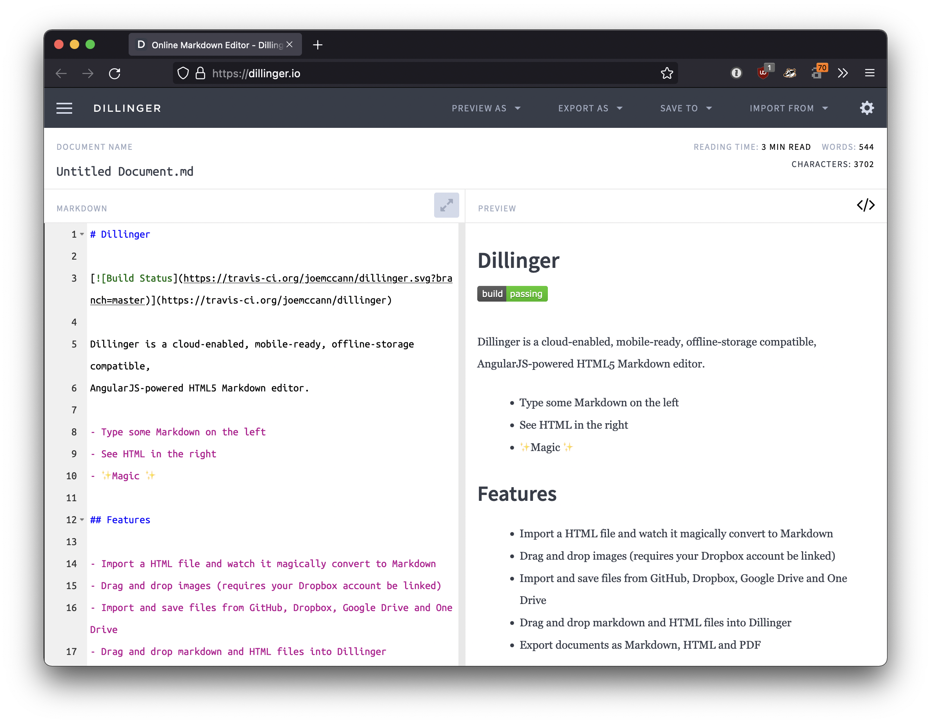
How do you open markdown files?
These files open in a simple text editor or Integrated Development editors like Visual Studio, Atom Sublime Text, Notepad++, and Intelli IDEA in Windows, UNIX, and MAC OS.
There are several online Markdown editors that you can use to try writing in Markdown. Dillinger is one of the best online Markdown editors. Just open the site and start typing in the left pane. A preview of the rendered document appears in the right pane.
Markdown Tutorial - Boopalan Sundaramoorthy | [6]

Slide 7
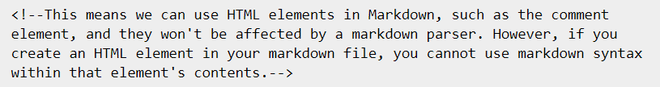
HTML Elements
Markdown is a superset of HTML, so any HTML file is valid Markdown.
Markdown Tutorial - Boopalan Sundaramoorthy | [7]

Slide 8
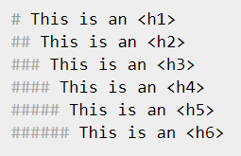
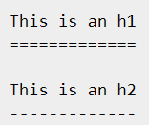
Headings
You can create HTML elements <h1> through <h6> easily by prepending the text you want to be in that element by a number of hashes (#).
Markdown also provides us with two alternative ways of indicating h1 and h2.
Markdown Tutorial - Boopalan Sundaramoorthy | [8]

Slide 9
Simple Text Styles
Text can be easily styled as italic or bold using markdown.
Style | Syntax | Example | Output
Bold | ** ** or __ __ | **This is bold text** | This is bold text
Italic | * * or _ _ | *This text is italicized* | This text is italicized
Strikethrough | ~~ ~~ | ~~This was mistaken text~~ | This was mistaken text
Bold and nested italic | ** ** and _ _ | **This text is _extremely_ important** | This text is extremely important
All bold and italic | *** *** | ***All this text is important*** | All this text is important
Markdown Tutorial - Boopalan Sundaramoorthy | [9]

Slide 10
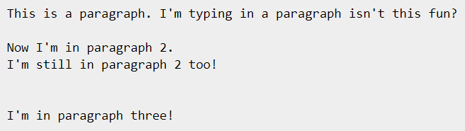
Paragraphs
Paragraphs are a one or multiple adjacent lines of text separated by one or multiple blank lines.
Markdown Tutorial - Boopalan Sundaramoorthy | [10]

Slide 11
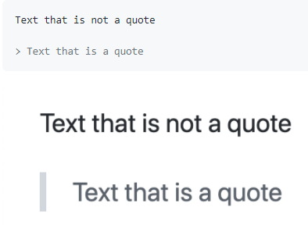
Blockquotes
To create a blockquote, add a > in front of a paragraph.
Markdown Tutorial - Boopalan Sundaramoorthy | [11]

Slide 12
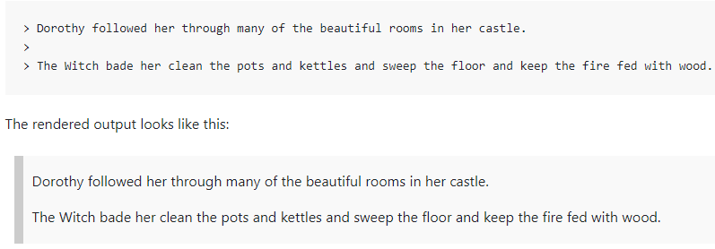
Blockquotes with Multiple Paragraphs
Blockquotes can contain multiple paragraphs. Add a > on the blank lines between the paragraphs.
Markdown Tutorial - Boopalan Sundaramoorthy | [12]

Slide 13
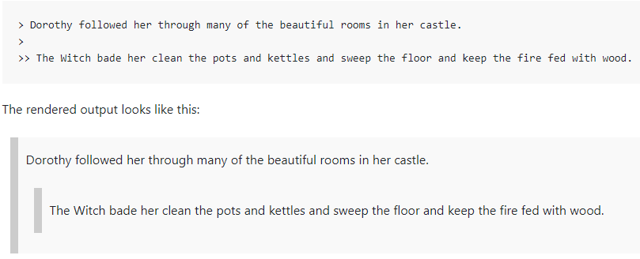
Nested Blockquotes
Blockquotes can be nested. Add a >> in front of the paragraph you want to nest.
Markdown Tutorial - Boopalan Sundaramoorthy | [13]

Slide 14
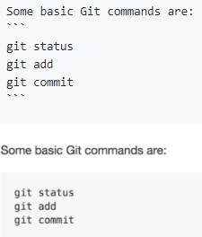
Quoting Code
You can call out code or a command within a sentence with single backticks. The text within the backticks will not be formatted. You can also press the Command+E (Mac) or Ctrl+E (Windows/Linux) keyboard shortcut to insert the backticks for a code block within a line of Markdown.
Use `git status` to list all new or modified files that haven't yet been committed.
To format code or text into its own distinct block, use triple backticks.
Markdown Tutorial - Boopalan Sundaramoorthy | [14]

Slide 15
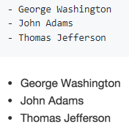
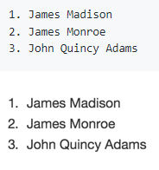
Lists
You can make an unordered list by preceding one or more lines of text with - or *.
To order your list, precede each line with a number.
Markdown Tutorial - Boopalan Sundaramoorthy | [15]

Slide 16
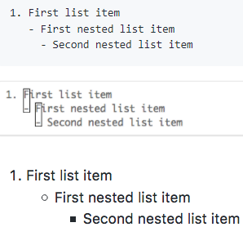
Nested Lists
You can create a nested list by indenting one or more list items below another item.
To create a nested list using the web editor on GitHub or a text editor that uses a monospaced font, like Atom, you can align your list visually. Type space characters in front of your nested list item, until the list marker character (- or *) lies directly below the first character of the text in the item above it.
Markdown Tutorial - Boopalan Sundaramoorthy | [16]

Slide 17
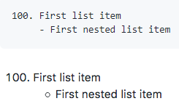
Nested Lists
To create a nested list in the comment editor on GitHub, which doesn't use a monospaced font, you can look at the list item immediately above the nested list and count the number of characters that appear before the content of the item. Then type that number of space characters in front of the nested list item.
In this example, you could add a nested list item under the list item 100. First list item by indenting the nested list item a minimum of five spaces, since there are five characters (100. ) before First list item.
Markdown Tutorial - Boopalan Sundaramoorthy | [17]

Slide 18
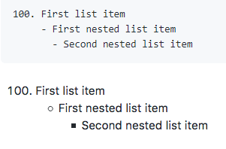
Nested Lists
You can create multiple levels of nested lists using the same method. For example, because the first nested list item has seven characters (␣␣␣␣␣-␣) before the nested list content First nested list item, you would need to indent the second nested list item by seven spaces.
Markdown Tutorial - Boopalan Sundaramoorthy | [18]

Slide 19
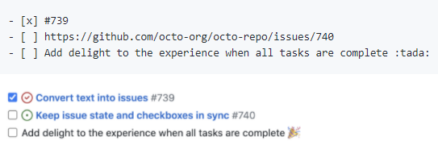
Task Lists
To create a task list, preface list items with a hyphen and space followed by [ ]. To mark a task as complete, use [x].
Markdown Tutorial - Boopalan Sundaramoorthy | [19]

Slide 20
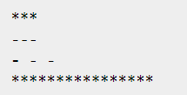
Horizontal Rule
Horizontal rules (<hr/>) are easily added with three or more asterisks or hyphens, with or without spaces.
Markdown Tutorial - Boopalan Sundaramoorthy | [20]

Slide 21
Links
One of the best things about markdown is how easy it is to make links. Put the text to display in hard brackets [] followed by the url in parentheses ()
[Click me!](http://test.com/)
You can also add a link title using quotes inside the parentheses.
[Click me!](http://test.com/ "Link to Test.com")
Relative paths work too.
[Go to music](/music/).
Markdown Tutorial - Boopalan Sundaramoorthy | [21]

Slide 22
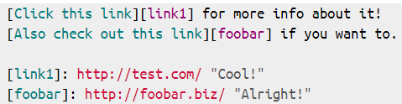

Links
Markdown also supports reference style links.
The title can also be in single quotes or in parentheses, or omitted entirely. The references can be anywhere in your document and the reference IDs can be anything so long as they are unique.
There is also "implicit naming” which lets you use the link text as the id.
Markdown Tutorial - Boopalan Sundaramoorthy | [22]

Slide 23

Images
You can display an image by adding ! and wrapping the alt text in [ ]. Then wrap the link for the image in parentheses ().
![This is the alt-attribute for my image](http://imgur.com/myimage.jpg "An optional title")
And reference style works as expected.
Markdown Tutorial - Boopalan Sundaramoorthy | [23]

Slide 24
Images
Here are some examples for using relative links to display an image.
Context | Relative Link
In a .md file on the same branch | /assets/images/electrocat.png
In a .md file on another branch | /../main/assets/images/electrocat.png
In issues, pull requests and comments of the repository | ../blob/main/assets/images/electrocat.png
In a .md file in another repository | /../../../../github/docs/blob/main/assets/images/electrocat.png
In issues, pull requests and comments of another repository | ../../../github/docs/blob/main/assets/images/electrocat.png?raw=true
Markdown Tutorial - Boopalan Sundaramoorthy | [24]

Slide 25
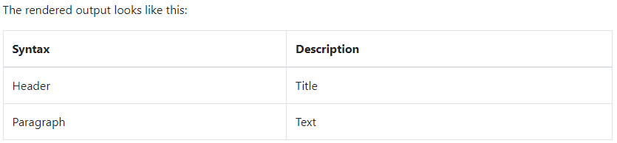
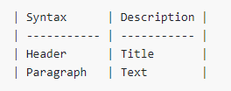
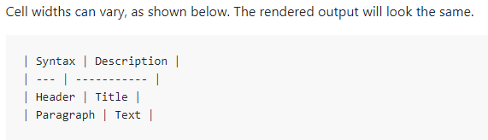
Tables
To add a table, use three or more hyphens (---) to create each column’s header, and use pipes (|) to separate each column. For compatibility, you should also add a pipe on either end of the row.
Tip: Creating tables with hyphens and pipes can be tedious. To speed up the process, try using the Markdown Tables Generator. Build a table using the graphical interface, and then copy the generated Markdown-formatted text into your file.
Markdown Tutorial - Boopalan Sundaramoorthy | [25]

Slide 26
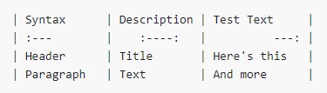
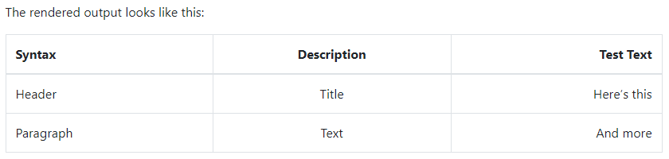
Tables - Alignment
You can align text in the columns to the left, right, or center by adding a colon (:) to the left, right, or on both side of the hyphens within the header row.
Markdown Tutorial - Boopalan Sundaramoorthy | [26]

Slide 27
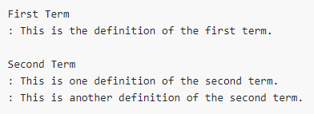
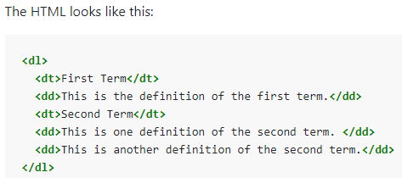
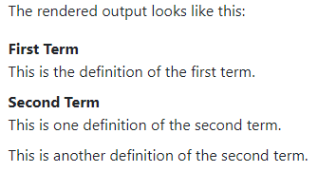
Definition Lists
Some Markdown processors allow you to create definition lists of terms and their corresponding definitions. To create a definition list, type the term on the first line. On the next line, type a colon followed by a space and the definition.
Markdown Tutorial - Boopalan Sundaramoorthy | [27]

Slide 28
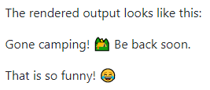

Emoji
There are two ways to add emoji to Markdown files: copy and paste the emoji into your Markdown-formatted text, or type emoji shortcodes.
Using Emoji Shortcodes
Some Markdown applications allow you to insert emoji by typing emoji shortcodes. These begin and end with a colon and include the name of an emoji.
Markdown Tutorial - Boopalan Sundaramoorthy | [28]

Slide 29

Highlight
This isn’t common, but some Markdown processors allow you to highlight text. The result looks like this. To highlight words, use two equal signs (==) before and after the words.
I need to highlight these ==very important words==.
Markdown Tutorial - Boopalan Sundaramoorthy | [29]

Slide 30
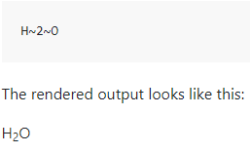
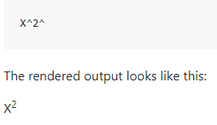
Subscript & Superscript
Subscript - This isn’t common, but some Markdown processors allow you to use subscript to position one or more characters slightly below the normal line of type. To create a subscript, use one tilde symbol (~) before and after the characters.
Superscript - This isn’t common, but some Markdown processors allow you to use superscript to position one or more characters slightly above the normal line of type. To create a superscript, use one caret symbol (^) before and after the characters.
Markdown Tutorial - Boopalan Sundaramoorthy | [30]

Slide 31
Markdown Cheat Sheet – Basic Syntax
Element | Markdown Syntax
Heading | # H1 ## H2 ### H3
Bold | **bold text**
Italic | *italicized text*
Blockquote | > blockquote
Ordered List | 1. First item 2. Second item 3. Third item
Unordered List | - First item - Second item - Third item
Element | Markdown Syntax
Code | `code`
Link | [title](https://www.example.com)
Image | ![alt text](image.jpg)
Horizontal Rule | ---
Markdown Tutorial - Boopalan Sundaramoorthy | [31]

Slide 32
Markdown Cheat Sheet – Extended Syntax
Element | Markdown Syntax
Table | | Syntax | Description | | ----------- | ----------- | | Header | Title | | Paragraph | Text |
Fenced Code Block | ``` { "firstName": "John", "lastName": "Smith", "age": 25 } ```
Heading ID | ### My Great Heading {#custom-id}
Definition List | term : definition
Element | Markdown Syntax
Strikethrough | ~~The world is flat.~~
Task List | - [x] Write the press release - [ ] Update the website - [ ] Contact the media
Highlight | I need to highlight these ==very important words==.
Subscript | H~2~O
Superscript | X^2^
Markdown Tutorial - Boopalan Sundaramoorthy | [32]

Slide 33
Markdown Tools Applications and components that support Markdown
AirSend – Collaboration Tool
Boostnote – Note taking application
Collected Notes – note-taking platform
Dillinger – Online Markdown editor
Ghost – Open source CMS
GitHub Pages – Service
Hugo – SSG
JeKyll – SSG
Reddit – Online Community
Slack – Messaging & collaboration app
VSCode – Open source code editor
and many more..
Markdown Tutorial - Boopalan Sundaramoorthy | [33]

Slide 34

Thank You
https://www.linkedin.com/in/boopalan-sundaramoorthy/

